Slide 1


Theme2: Strengthening Risk Governance Within the Agricultural and FNS sector to achieve effective Disaster Risk Management (DRM)
Experience - Development and Implementation of the Disaster Risk Management Plan for the Agricultural Sector 2013-2020 - GUYANA

Slide 2
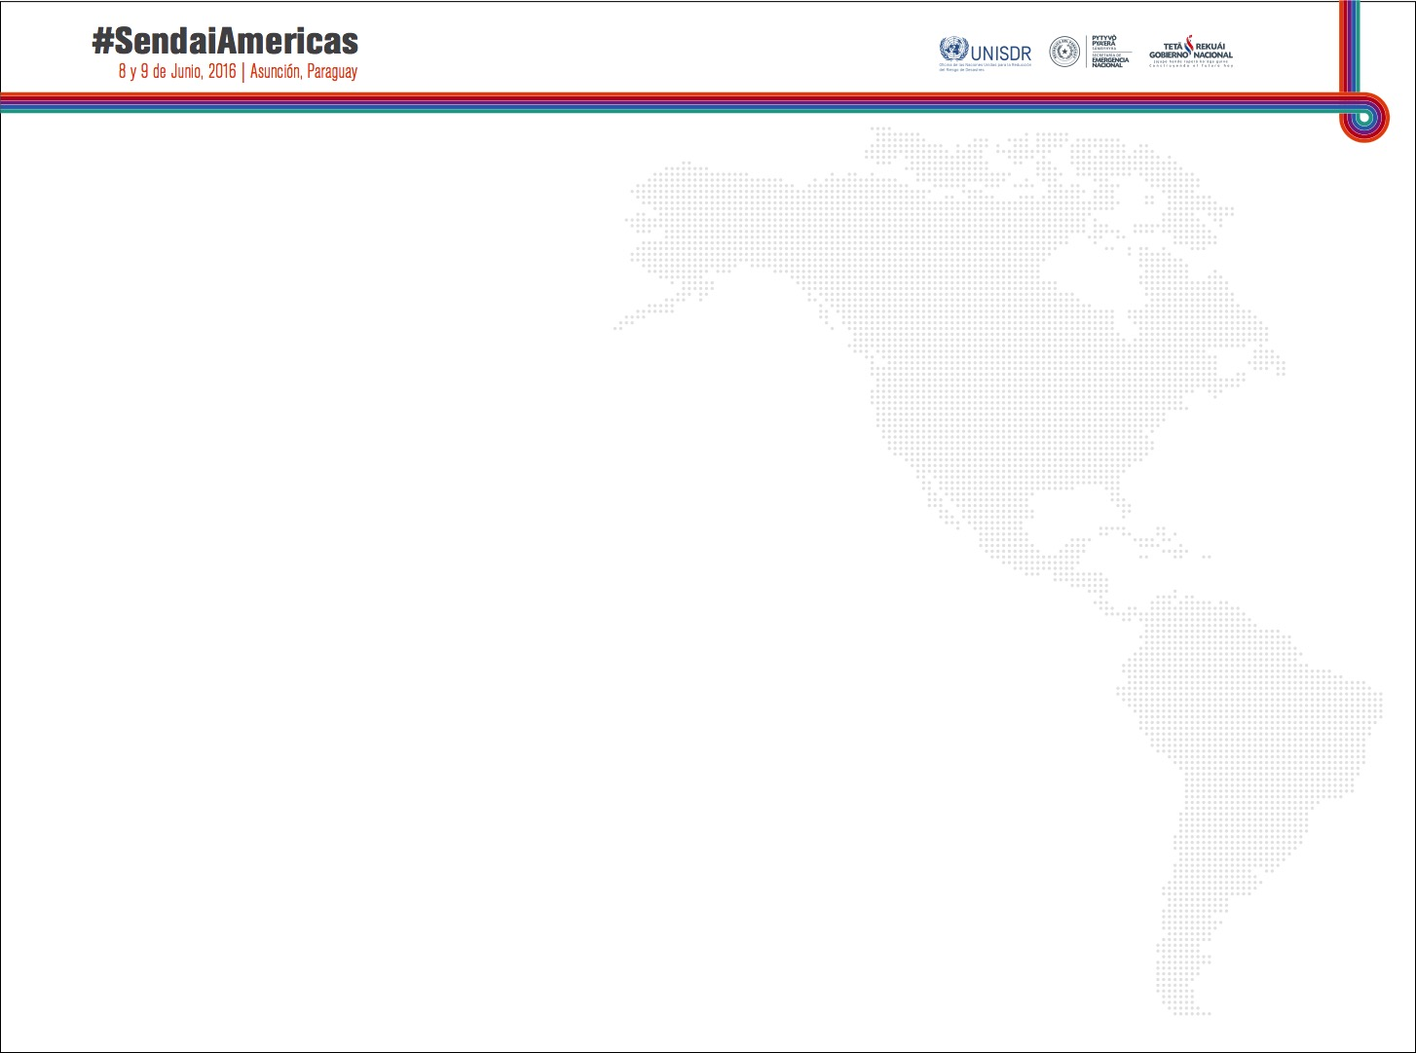
Format of Presentation
(1) Development of Dedicated Policy/Plan and Monitoring Instruments - Development and Implementation of the Disaster Risk Management Plan for the Agricultural Sector 2013-2020 - GUYANA – Address - Successful Country Experience: include Highlights of achievements
(2) Challenges – Address – (i) creation of dedicated DRM mechanisms with enough human and financial resources allocation and (2) development of effective mechanisms and inter-sectoral coordination
(3) Opportunities

Slide 3
Background (History DRM)
Agri Sector- MOA – Prior 2013
Reactive – Action was taken when a threat of disaster/disaster occurred
No pre-designated person(s) to address DRR
Informal - No documented plan of action to follow – Ministry’s extension personnel collaborated efforts and integrated with relevant personnel
No definitive format for collection and dissemination of information

Slide 4
Development of Policies/Plan
(DRM Plan for Agri Sector )
Realizing Guyana’s susceptibility to a number of hazards, effects of Climate Change and mandates for sectoral Planning (Civil Defence Commission (CDC) - MOA requested technical assistance from FAO for development of a Disaster Risk Management Plan for the Agriculture Sector.
Commenced: 2012 - Completed: 2013
Developed by MOA with technical Assistance from FAO - Technical Cooperation Programme
Participatory

Slide 5
Development of Policies/Plan
(DRM Plan - Vision and Objectives)
Vision
Sustained economic and social prosperity through
improved agriculture risk reduction
and disaster risk management
Objectives
Strengthen capacities prevention and mitigation of disaster impacts, restoration of livelihoods - ( via well-coordinated mechanism).
Improve decision making and coordination (DRM) among stakeholders
Mechanism for integrated financial resource mobilization

Slide 6
Development of Policies/Plan
(DRM Plan for Agri Sector )
The Plan is structured around the following four (4) Result Areas:
Result Area 1 - Strengthening institutional and technical capacities within the agriculture sector,
Result Area 2 - Risk identification, information system and early warning,
Result Area 3 - Building resilience for sustainable livelihoods in the agriculture sector, and
Result Area 4 - Preparedness, response and rehabilitation.
Result Areas have clearly defined outcomes, outputs, activities, M&E (Baseline, Targets, Indicators)
,

Slide 7
ADRM - FNS Synergies
Output 4.6 (DRM Plan for Agri):
Capacities for food and nutrition security particularly in at-risk communities enhanced.
Emphasizes -Implementation of Goal 1 of the FNS Strategy 2011-2020
Food and Nutrition Security Strategy 2011-2020
Overall goal - to improve the health and well – being…through enhanced food and nutrition security
Specific Goals:
Goal 1 - Objective – Reduce vulnerability/risk to natural disasters and economic crises – in particular - coastal flooding and high food prices

Slide 8
(DRM Plan for Agri Sector ) FNS Synergies – Examples of Achievements (Context - Sendai Framework)
Priority 1 - Understanding Disaster Risk
Data Collection and Analysis, Baseline etc.
Gaps in existing livelihood baseline data addressed – NGMC - Agricultural production data placed in farmer’s database (FAO)
- PTCCB in collaboration with FAO - established inventory of obsolete pesticides stock in Guyana.
Training and Information Dissem.- Livelihood Baselines and Damage and Loss Assessment for Disaster Risk Management (FAO)
- Monthly Farmers Weather Bulletin - Hydromet Dept.
Design for the construction of the facilities for feed formulation, research and development and training done by GLDA. (eg. Silage Pits.)
New Course Water Management – incorporated DRM and CCA – GSA
DRM and CCA Thematic areas included in courses; Hydrometeorology, Soil Science, GAP and Farm Practical.
- Capabilities for Food and Nutrition Security Enhanced - Certificate in Agro processing Programme introduced at GSA

Slide 9
(DRM Plan for Agri Sector ) FNS Synergies – Examples of Achievements (Context - Sendai Framework)
Priority 2 – Strengthening DR Governance to Manage DR
Policy and Institutional Support - Development and Implementation of ADRM Plan - Coordinating Unit (Informal), National Oversight Committee established, Agency MOA (DRM) Committee established, Agency Focal Points (DRM)appointed
Progress Reports on Implementation of Plan (3)
Presence of senior decision makers within agriculture sector maintained on the National DRR Platform
Inter-sectoral collaboration (national Oversight Committee – CDC, IICA, FAO, MOH, Caricom, etc.
Detailed Pesticides and Toxic Chemicals Emergency Response Plan was developed for Guyana. - Training for major chemical importers and vendors conducted
Mainstreaming - Project: Building Resilience and Sustainable Livelihood: Mainstreaming Disaster Risk Management (DRM) into the Agriculture Sector in Guyana - (UNDP/FAO/GOG)

Slide 10
(DRM Plan for Agri Sector ) FNS Synergies – Examples of Achievements (Context - Sendai Framework)
Priority 3 – Investing in DRR for Resilience
Silage bins in use, hay baling done by GLDA, molasses urea block technology transferred to farming community,
Building Codes- Information on designs and layouts of pens are communicated to farmers in vulnerable areas, so as to minimize negative impacts.
Chemical storage facility built and commissioned
Empoldering cattle pastures in flood prone areas.
Agro-met stations established and re-established
Supply Chains (Consultancy – FAO - NGMC)
Priority 4 – Enhancing Disaster Preparedness for effective Response and “Build back Better’….
Drills/Simulation Exercises (agency level)
Promote sustained procurement and storage of adequate veterinary supplies
Improved genetic material, technology packages for farmers

Slide 11
Monitoring Instruments -

Slide 12
Structures and Mechanisms
NATIONAL
Minister of Agriculture or Representative
National DRR Platform
Sectoral ADRM Committee
DRM Secretariat
DRM Coordinator
Admin. Assistant
MOA AGENCY AND DEPARTMENT
DRM Focal Point and Sub Committee
DRM Focal Point and Sub Committee
REGIONAL LEVEL
MOA Regional Coordinator
Regional Disaster Committee

Slide 13
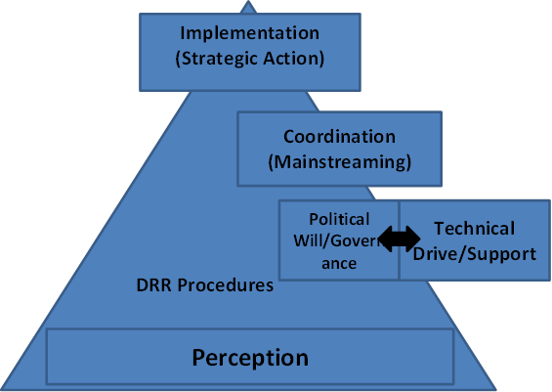
Challenges
Perception reflected in actions of actors in all of the categories Represented
Largely Reactive - negative effect on budgetary allocation and planning
Continuous Projects/Programmes - training, empoldering, construction and maintenance of infrastructure (roads, bridges, pens etc.)
Achievements - Single - Action-oriented - not in holistic framework demonstrating Governance

Slide 14
Lessons Learnt
DRR is not a ‘side-event’ or part-time project
Full time and permanent programme to be integrated with all other programmes
Observe and not substitute designated structures and mechanisms

Slide 15
Opportunities
Build on experiences – avoid previous pitfalls
Knowledge-sharing fora
Collaborative Programmes (Across agencies and Countries)
Enhanced Political Will – eg. this forum and others
Needs-based Assessment - Targeted training and skill development
More Strategic Implementation - emphasis on Mainstreaming
More Focused approach for Resource Allocation
THANK YOU

